Slide 1


Erica Frisch
9/30/2022

Slide 2

Outline
Executive Summary
Introduction
Methodology
Results
Conclusion
Appendix

Slide 3
Executive Summary
Summary of methodologies
Data was collected from the SpaceX API and scraped from the SpaceX Wikipedia webpage. The data was analyzed and cleaned. Missing values were corrected where necessary. After gathering insights with graphs and summary statistics from the data, features were selected. With the selected features, predict models were trained and hyperparameters were fine-tuned with grid search. Models were tested with test data and each model was scored.
Summary of all results
While cleaning the data, there were 5 values for payload mass that were missing. The mean value was used to replace the missing values. From graphing, a relationship between reuse of the first stage rocket and several features were identified. The models tested all had similar accuracy scores of 83%. Since all of the tested models performed similarly, the Logistic Regression was selected for the added feature of providing the probability of being able to reuse first stage rockets.

Slide 4
Introduction
Project background and context
Rocket launches can have some sky-high price tags, upwards of $165 million each. Reusing the first stage rockets can be bring that cost a little more down to earth at about $62 million. Being able to predict when a rocket can be reused can lead to understanding the conditions in which a rocket can be reused.
Problems you want to find answers
We want to be able to predict when a first stage rocket can be reused. With a model that can predict this, we can determine the cost of a launch for customers.

Slide 5

Section 1

Slide 6
Methodology
Executive Summary
Data collection methodology:
Describe how data was collected
Perform data wrangling
Describe how data was processed
Perform exploratory data analysis (EDA) using visualization and SQL
Perform interactive visual analytics using Folium and Plotly Dash
Perform predictive analysis using classification models
How to build, tune, evaluate classification models

Slide 7
Data Collection
Data was pulled from the SpaceX API using the requests library. Additional information was obtained by scraping the SpaceX Wikipedia webpage using the BeautifulSoup library.
API pull and webscrape
Handle missing or null values
Convert to correct data types (i.e. float64)
Select key features
One Hot Encoding

Slide 8
Data Collection – SpaceX API
Spacex Data Collection API notebook
Requests library was used for the API calls
https://api.spacexdata.com/v4
capsules
cores
Launches/past

Slide 9
Data Collection - Scraping
Requests.get(url)
BeautifulSoup
Extract title soup.title
Parse table data
Extract column names find_all(‘th’)
Find all tables soup.find_all(‘tables)
Export to dataframe
Save to file
Data Collection with Webscraping notebook
Pulled data with requests library and used the BeautifulSoup library to extract data.

Slide 10
Data Wrangling
Describe how data were processed
You need to present your data wrangling process using key phrases and flowcharts
Add the GitHub URL of your completed data wrangling related notebooks, as an external reference and peer-review purpose
Identify missing values
Fill missing values with mean where applicable
Convert data to float64
Select key features
One Hot Encoding

Slide 11
EDA with Data Visualization
Flight number vs Payload with hue for Success
Flight number vs Launch Site with hue for Success
Payload Mass vs Launch Site with hue for Success
Orbit vs Success Rate
Flight number vs Orbit
Payload vs Orbit
Year vs Success Rate
Data Visualization Notebook

Slide 12
EDA with SQL
Get the names of the launch sites
Display 5 records of launches from site names containing ‘CCA’
Display total payload from launches by NASA (CRS)
Display average payload for booster F9 v1.1
Display the first date of a successful landing on a ground pad
Display names of boosters with success on drone ship and payload mass between 4,000 and 6,000 kg
Display total number of mission successes and failures
Display names of boosters that carried the max payload
Display records for the year 2015
SQL Data Analysis Notebook

Slide 13
Build an Interactive Map with Folium
Map launching locations with markers for each launch color coded based on success and a line from CCAFS launch sites to the coastline.
Creates a visual representation of how many launches were successful and failures for each launch site
Interactive Visual Analytics with Folium notebook

Slide 14
Build a Dashboard with Plotly Dash
Pie chart with distribution of successful launches by site with a drop down to see a breakdown of successes and failures by launch site
Scatter plot with payload by success colored by booster with slider to change the payload window on the x-axis
Visual representations of successes by launch site and payload.
Plotly Dashboard

Slide 15
Split data into training and testing sets
Use Grid Search to optimize hyperparameters
Train model with training data
Test model with testing data
Evaluate model
Predictive Analysis (Classification)
Logistic Regression was built using Grid Search to optimize hyperparameters, evaluated with a confusion matrix and accuracy score.
Machine Learning notebook

Slide 16
Results
Exploratory data analysis results
Interactive analytics demo in screenshots
Predictive analysis results

Slide 17

Section 2

Slide 18
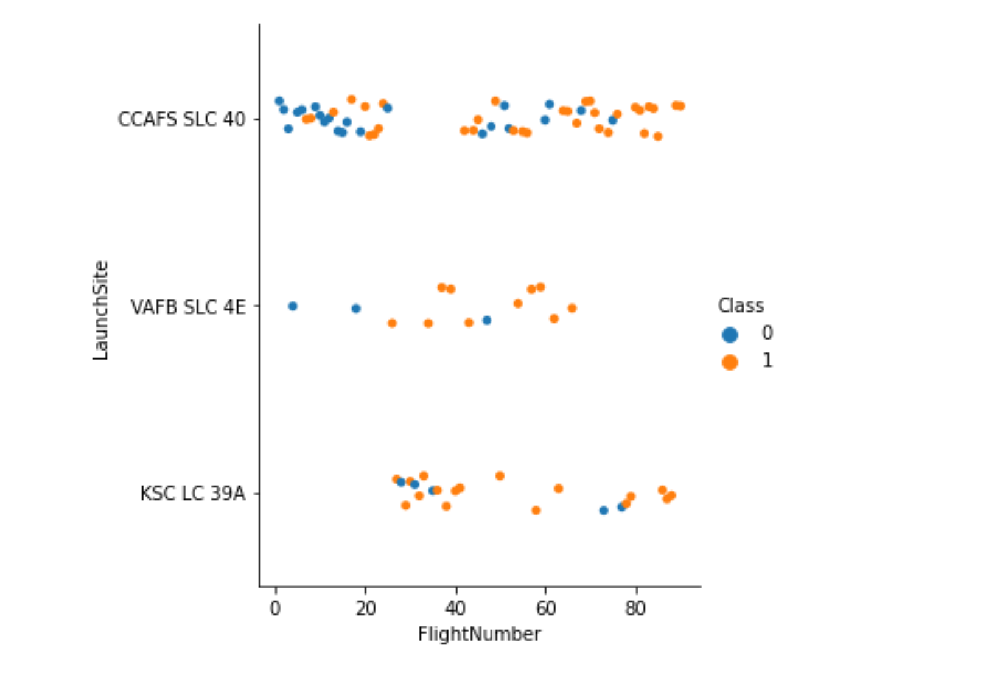
Flight Number vs. Launch Site
Show a scatter plot of Flight Number vs. Launch Site
Show the screenshot of the scatter plot with explanations

Slide 19
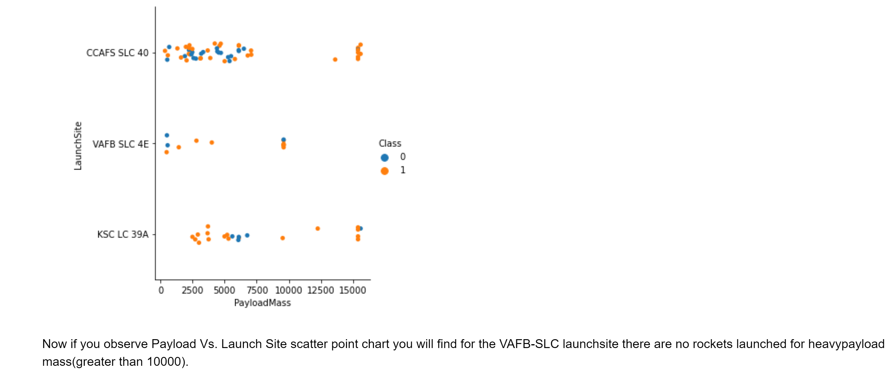
Payload vs. Launch Site
Show a scatter plot of Payload vs. Launch Site
Show the screenshot of the scatter plot with explanations

Slide 20
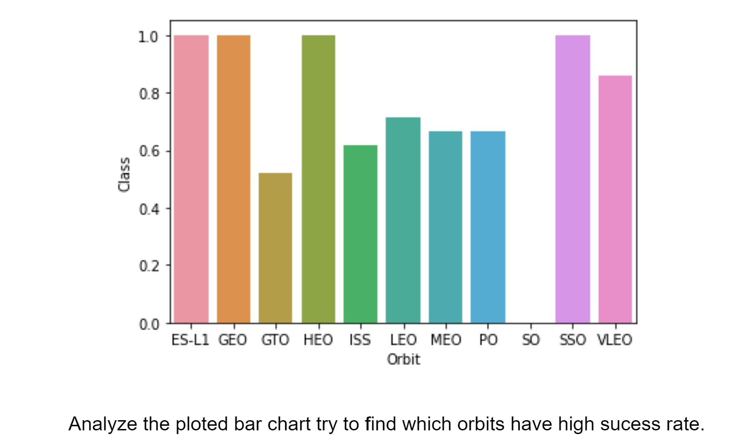
Success Rate vs. Orbit Type
Show a bar chart for the success rate of each orbit type
Show the screenshot of the scatter plot with explanations

Slide 21
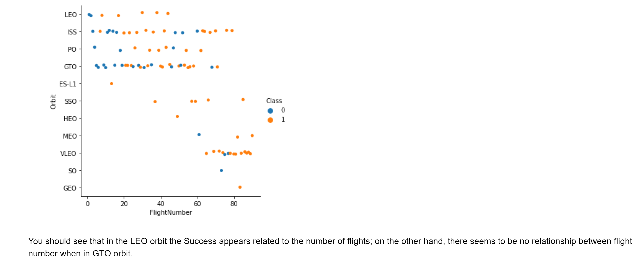
Flight Number vs. Orbit Type
Show a scatter point of Flight number vs. Orbit type
Show the screenshot of the scatter plot with explanations

Slide 22
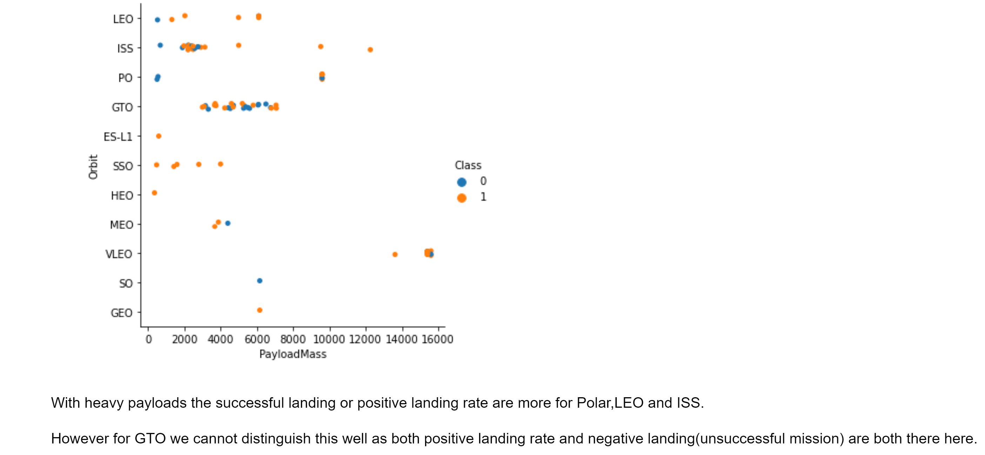
Payload vs. Orbit Type
Show a scatter point of payload vs. orbit type
Show the screenshot of the scatter plot with explanations

Slide 23
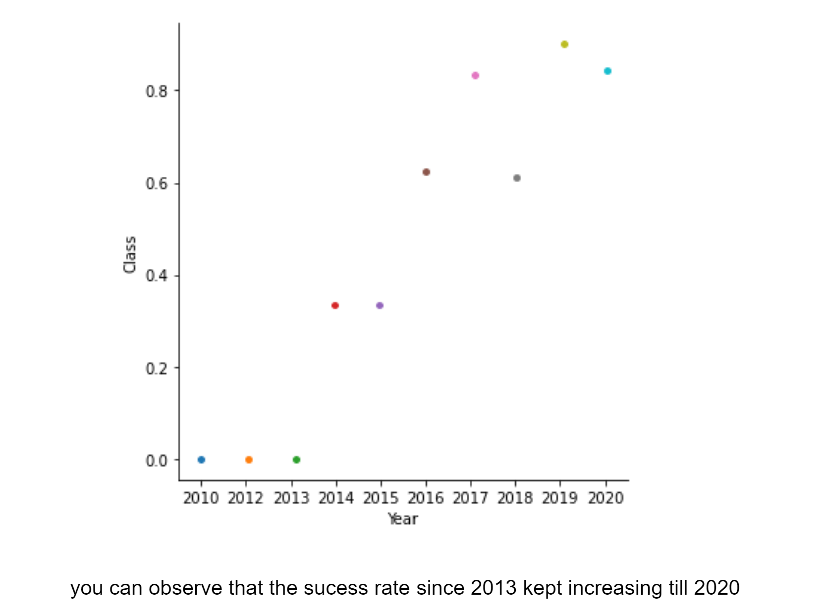
Launch Success Yearly Trend
Show a line chart of yearly average success rate
Show the screenshot of the scatter plot with explanations

Slide 24
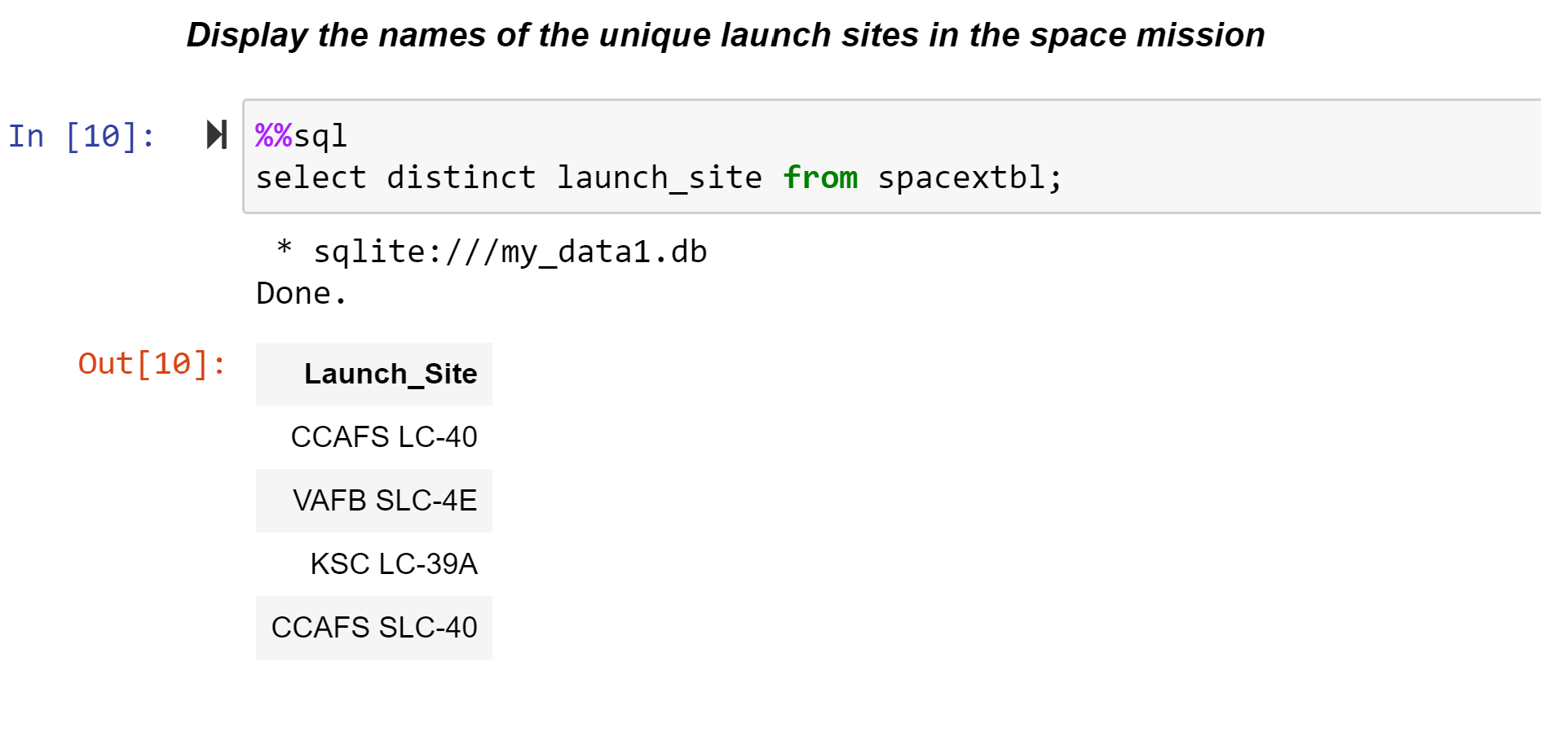
All Launch Site Names
Find the names of the unique launch sites
Present your query result with a short explanation here

Slide 25
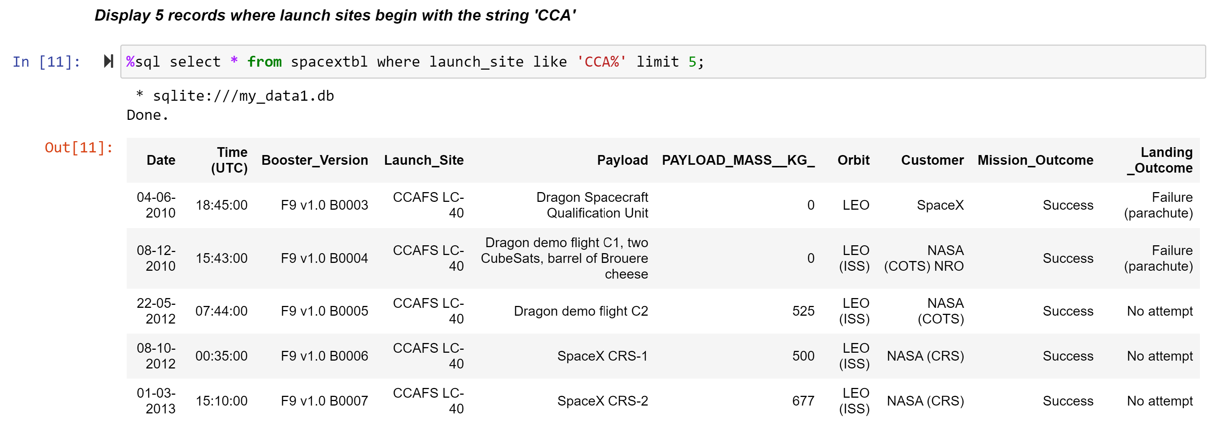
Launch Site Names Begin with 'CCA'
Find 5 records where launch sites begin with `CCA`
Present your query result with a short explanation here

Slide 26
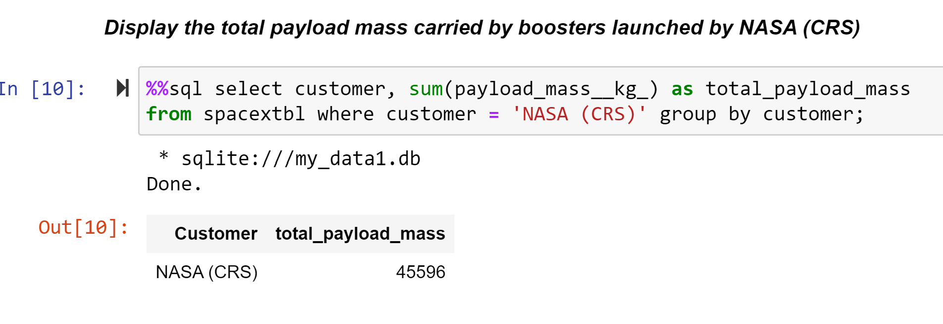
Total Payload Mass
Calculate the total payload carried by boosters from NASA
Present your query result with a short explanation here

Slide 27
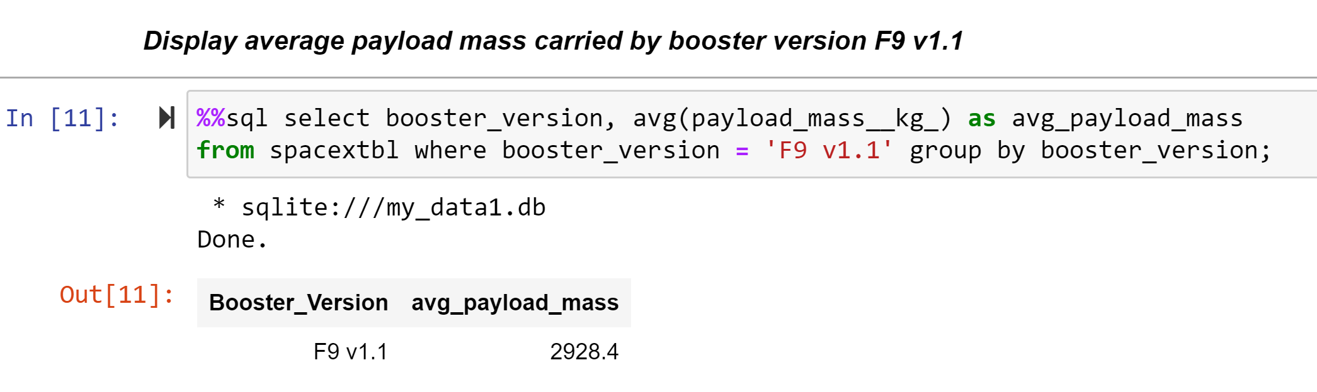
Average Payload Mass by F9 v1.1
Calculate the average payload mass carried by booster version F9 v1.1
Present your query result with a short explanation here

Slide 28
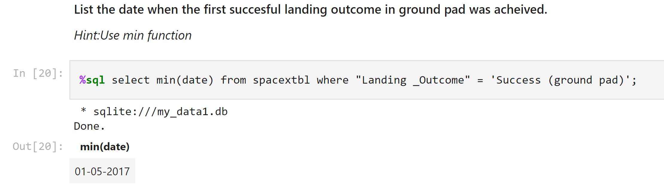
First Successful Ground Landing Date
Find the dates of the first successful landing outcome on ground pad
Present your query result with a short explanation here

Slide 29
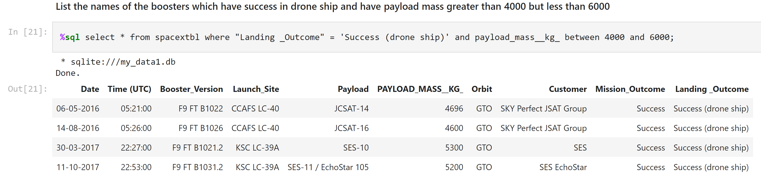
Successful Drone Ship Landing with Payload between 4000 and 6000
List the names of boosters which have successfully landed on drone ship and had payload mass greater than 4000 but less than 6000
Present your query result with a short explanation here

Slide 30
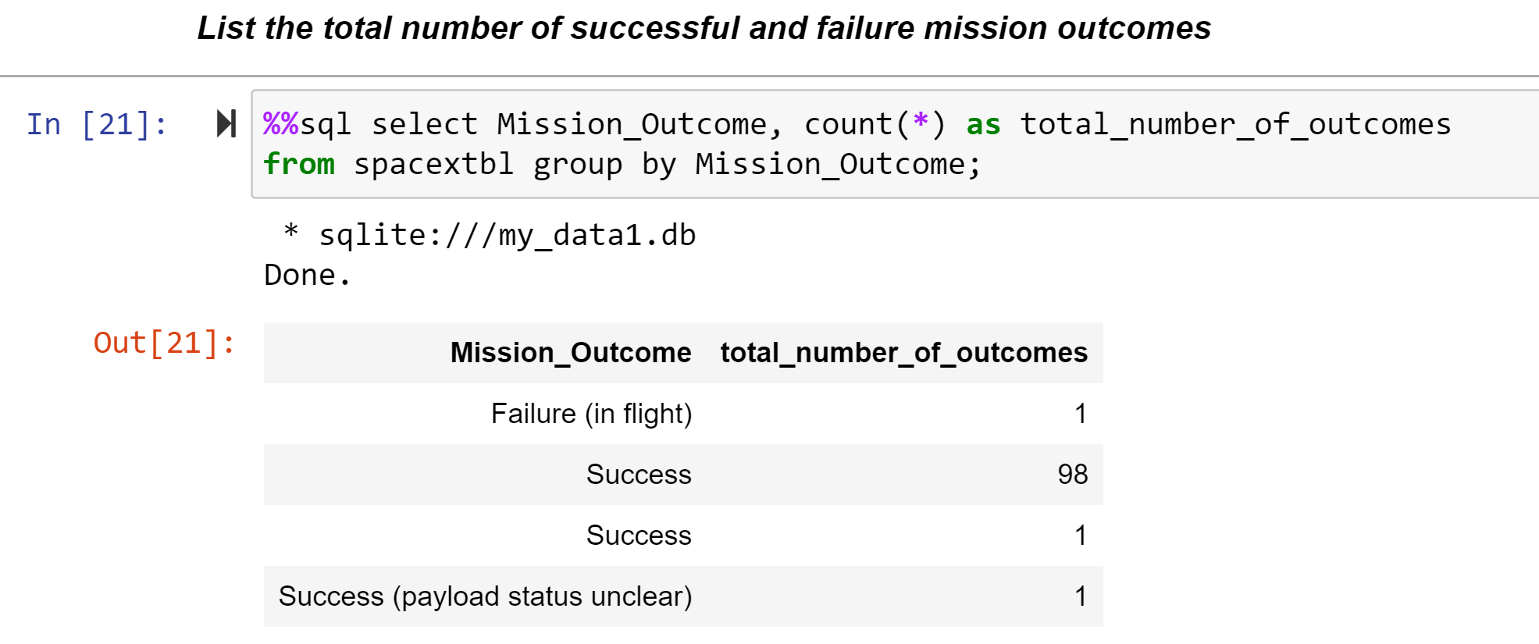
Total Number of Successful and Failure Mission Outcomes
Calculate the total number of successful and failure mission outcomes
Present your query result with a short explanation here

Slide 31
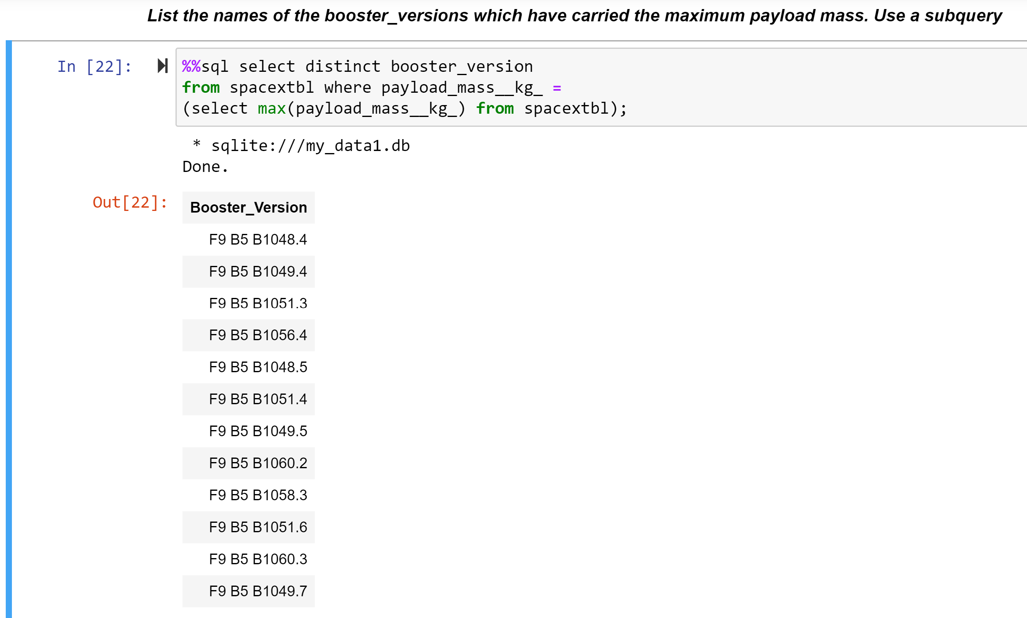
Boosters Carried Maximum Payload
List the names of the booster which have carried the maximum payload mass
Present your query result with a short explanation here

Slide 32
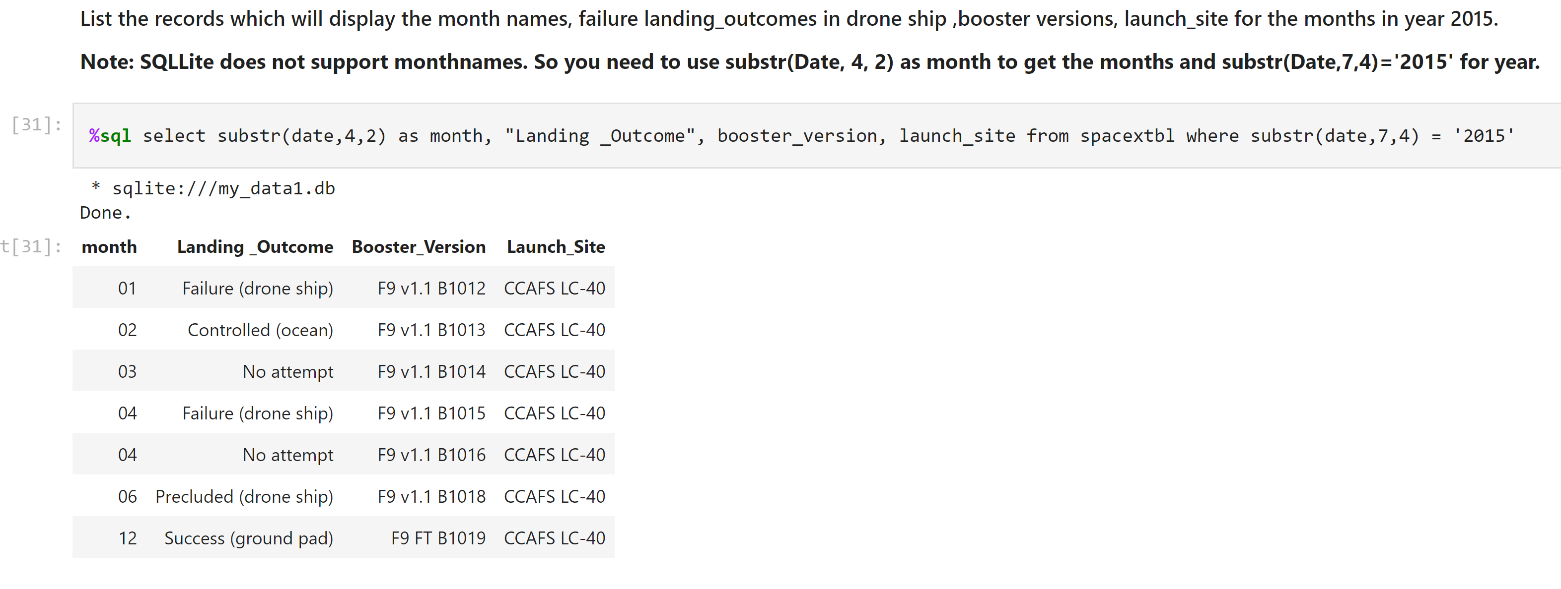
2015 Launch Records
List the failed landing_outcomes in drone ship, their booster versions, and launch site names for in year 2015
Present your query result with a short explanation here

Slide 33
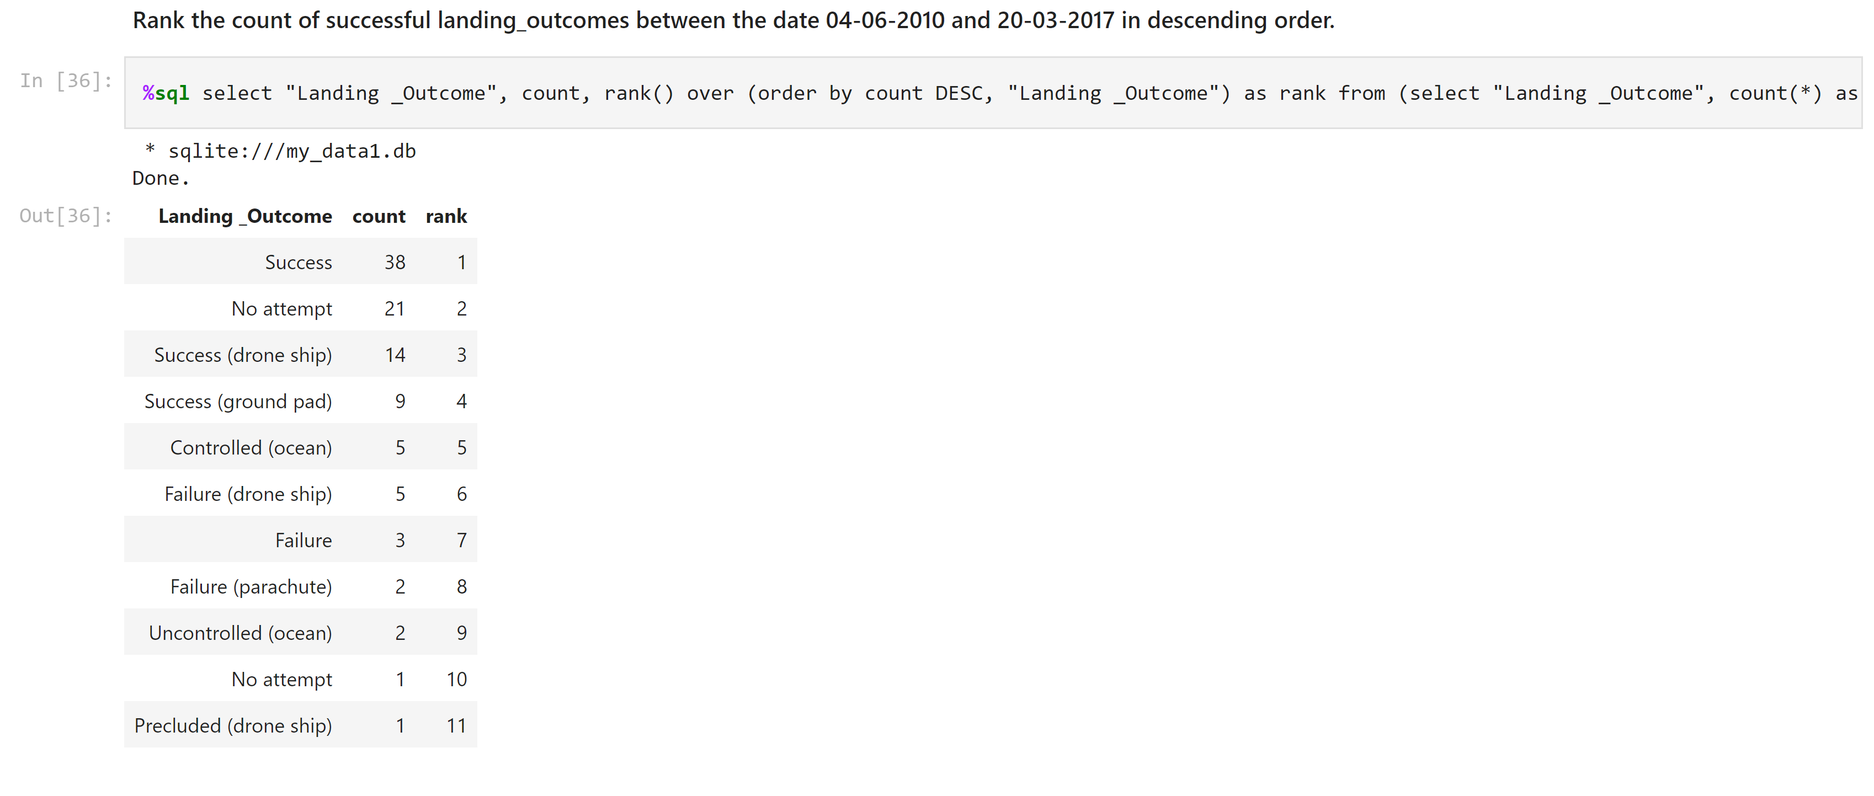
Rank Landing Outcomes Between 2010-06-04 and 2017-03-20
Rank the count of landing outcomes (such as Failure (drone ship) or Success (ground pad)) between the date 2010-06-04 and 2017-03-20, in descending order
Present your query result with a short explanation here

Slide 34

Section 3

Slide 35
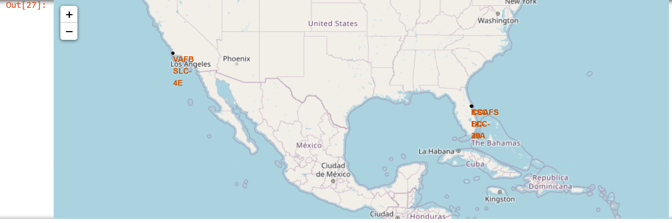
Map of Launch Sites
Location of launch sites

Slide 36
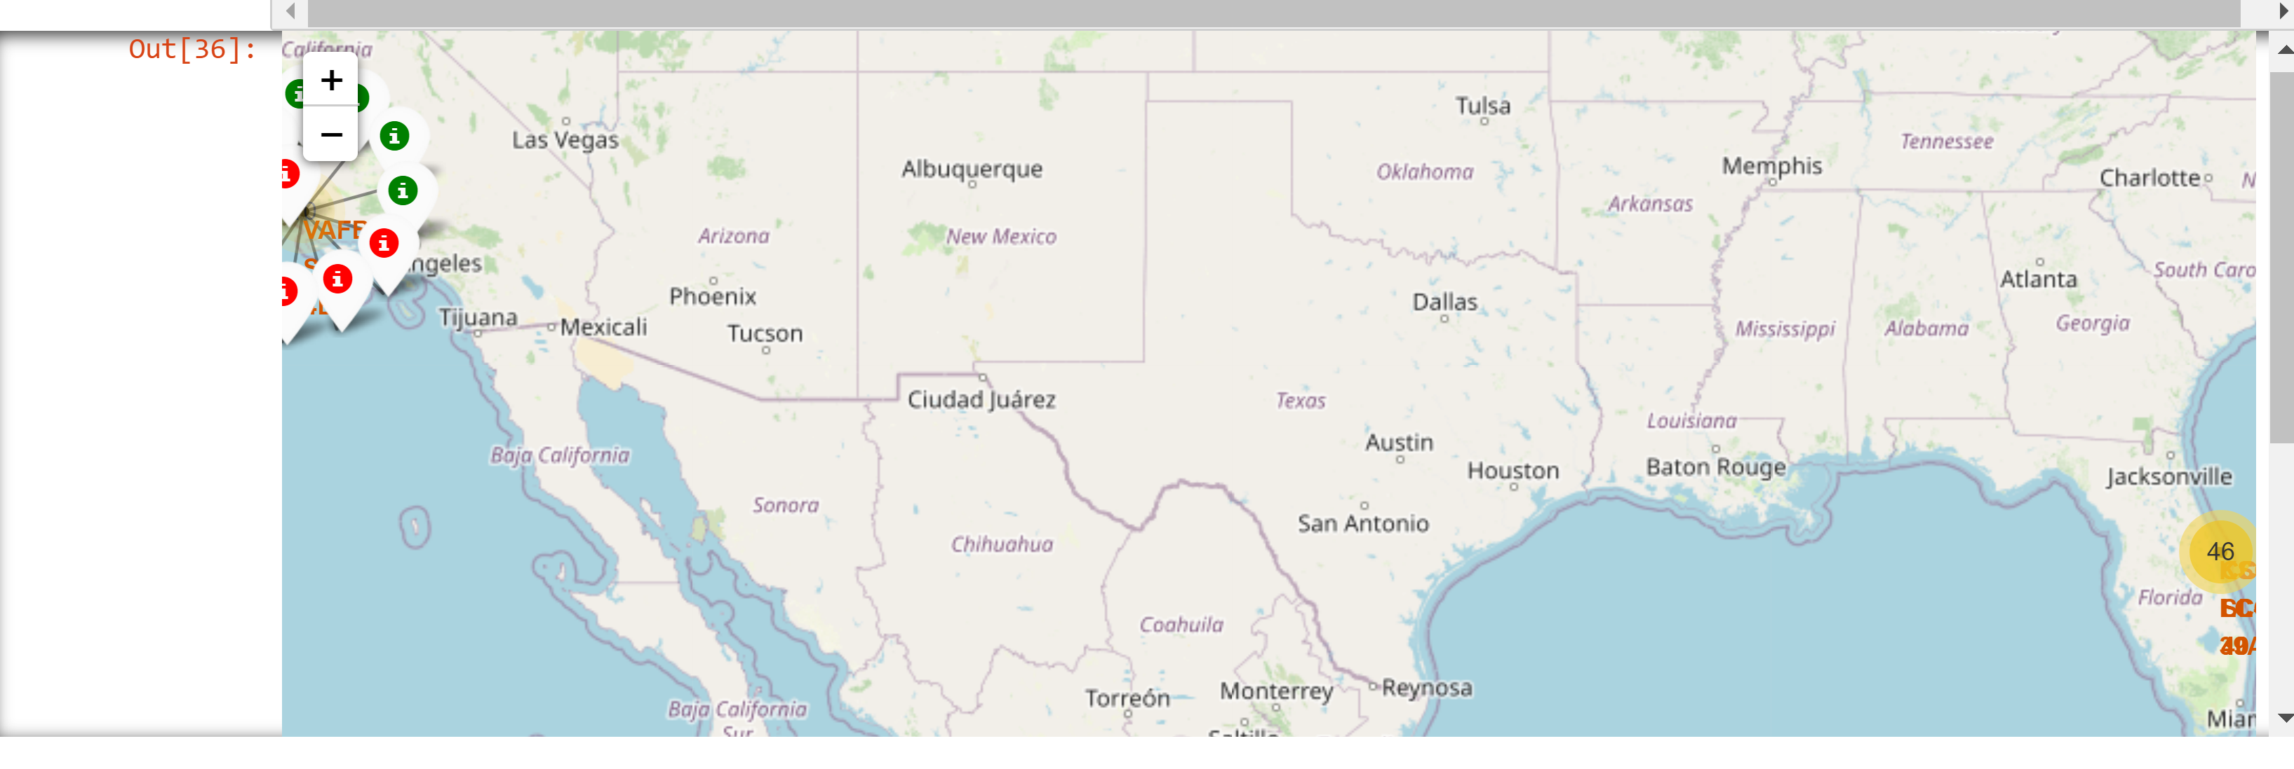
Map of Launch Site per launch by success
A pin for each launch at the appropriate launch site colored green for success, red for failure

Slide 37
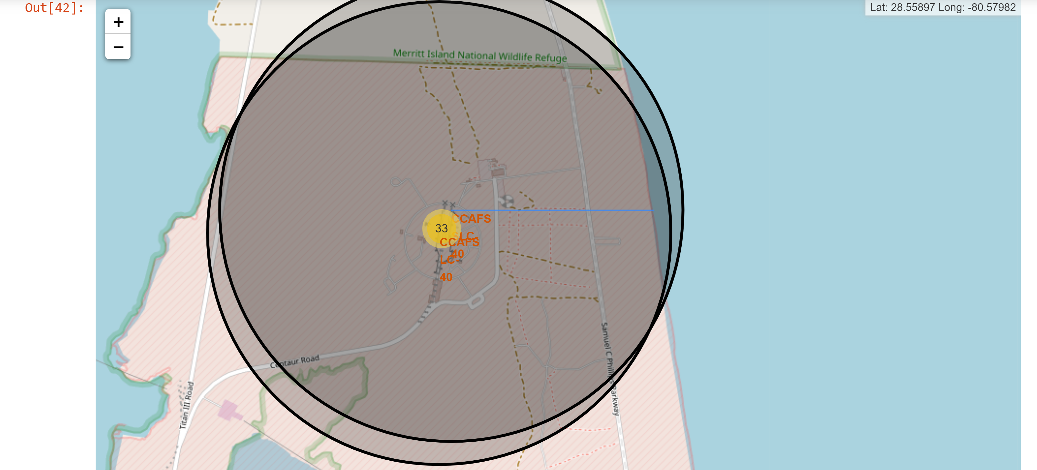
Launch Site to Coastline
Includes line to the coastline

Slide 38

Section 4

Slide 39
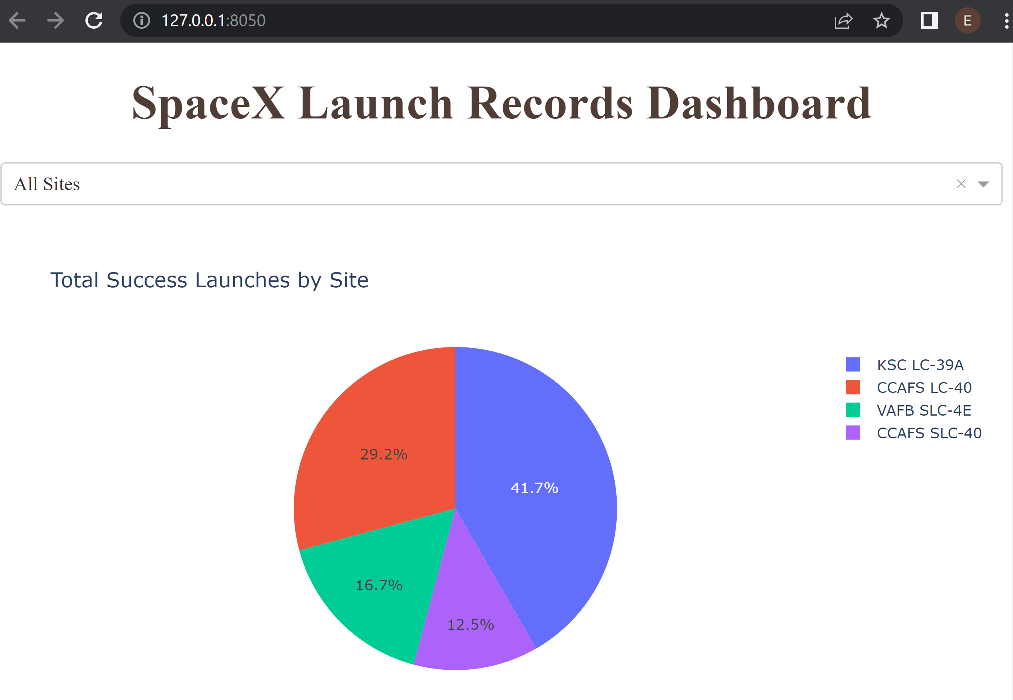
Total Success Launches by Site
Percentage of total successful launches by site

Slide 40
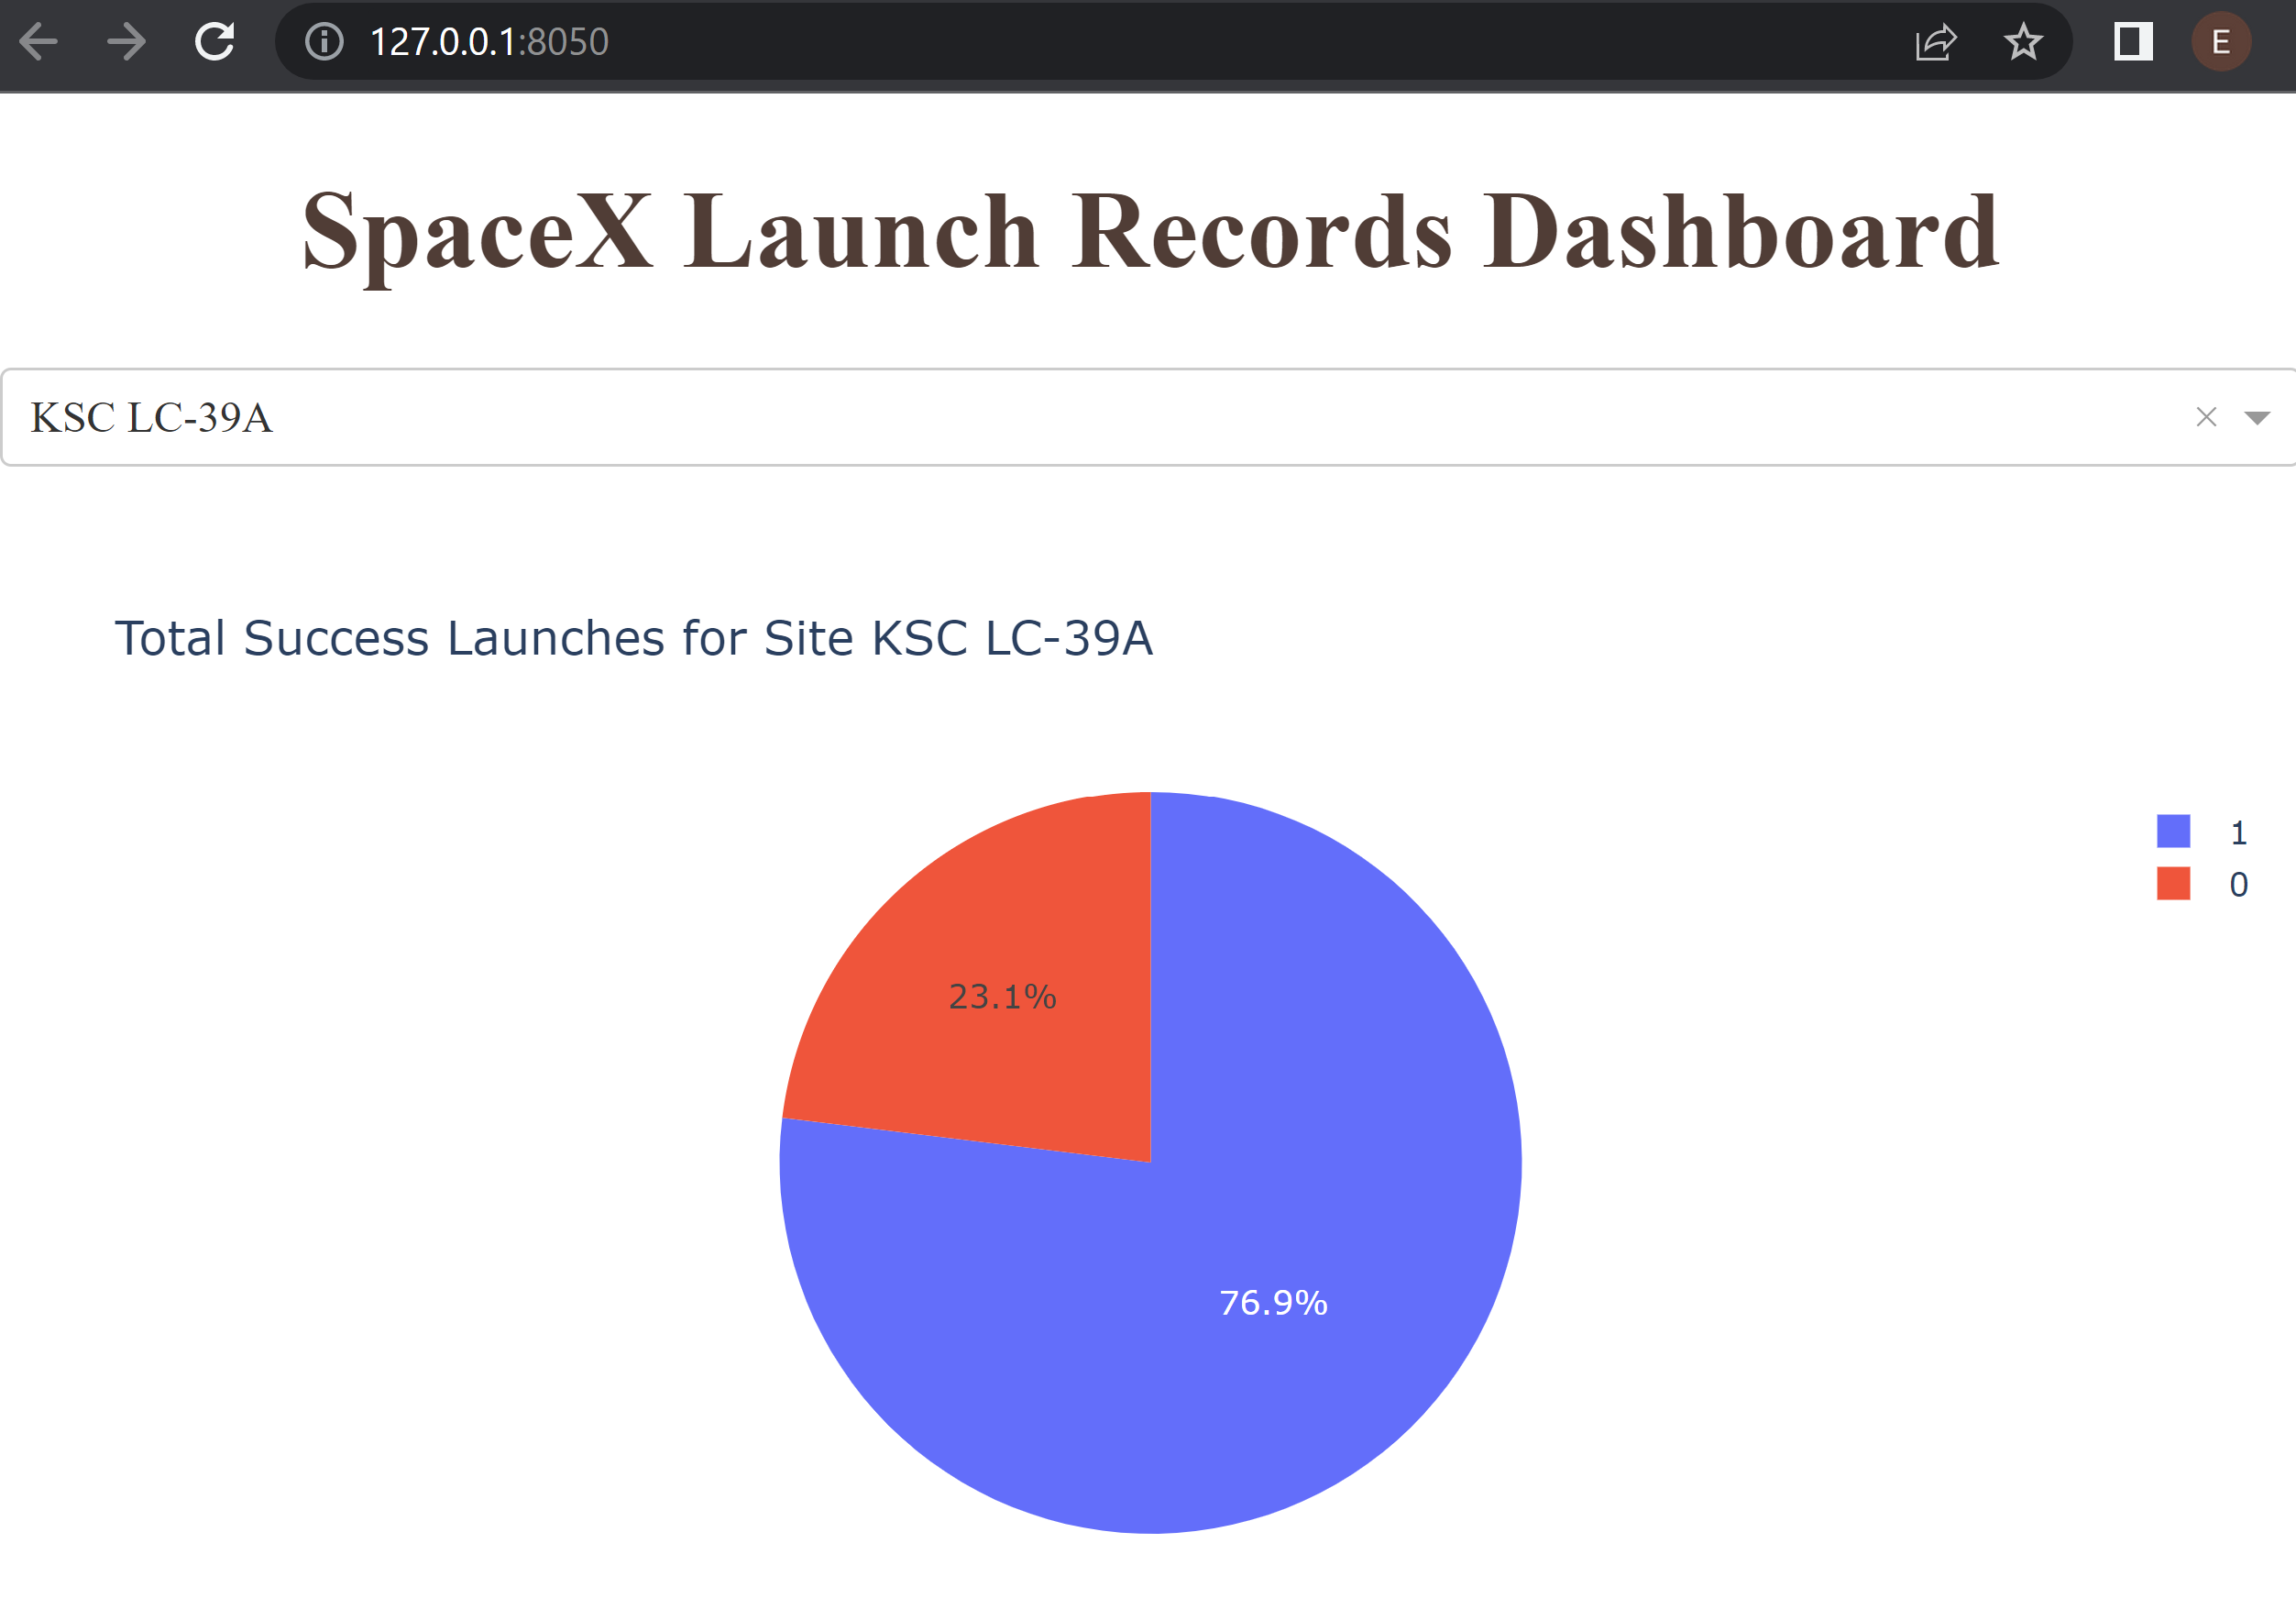
Success Ratio for KSC LC-39A
Ratio of successful launches for KSC LC-39A

Slide 41
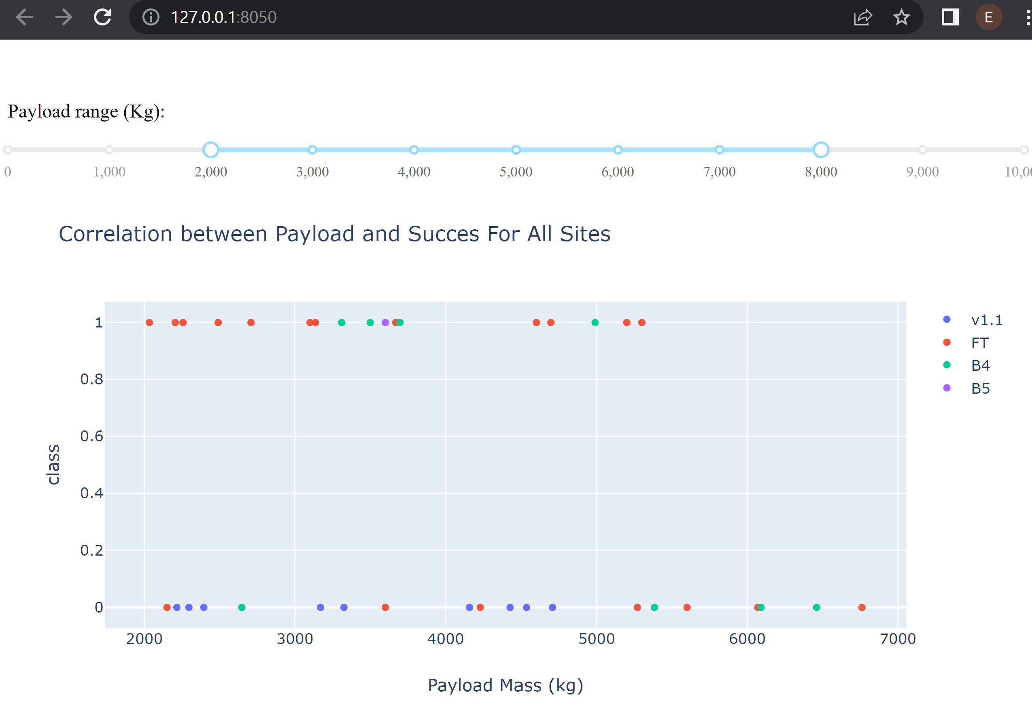
Payloads Between 2,000 kg and 8,000 kg for All Launch Sites
Smaller payloads have a higher success rate

Slide 42

Section 5

Slide 43
Classification Accuracy
Visualize the built model accuracy for all built classification models, in a bar chart
Find which model has the highest classification accuracy

Slide 44
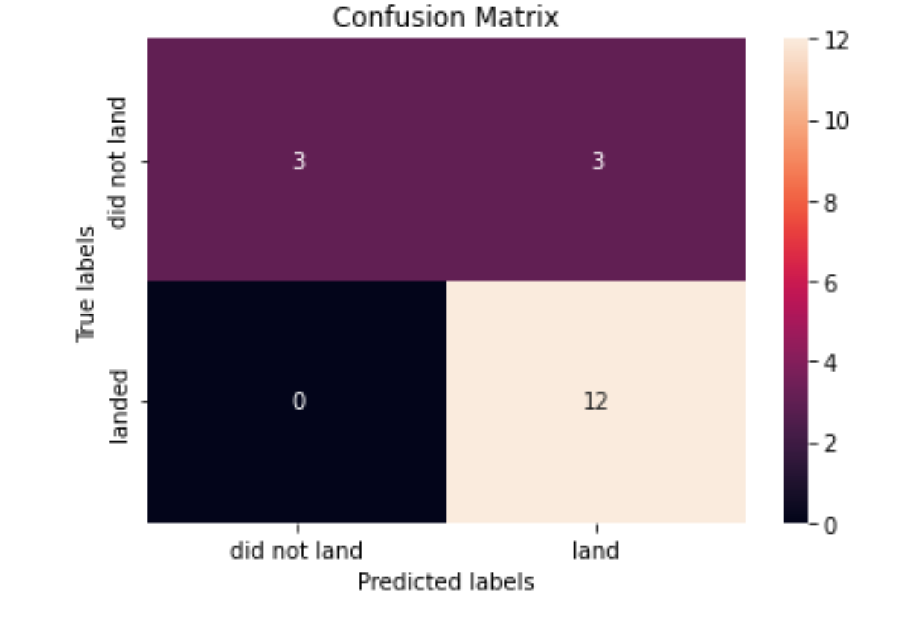
Confusion Matrix
Show the confusion matrix of the best performing model with an explanation

Slide 45
Conclusions
All models performed the same
Lower payloads had better success

Slide 46
Appendix
Include any relevant assets like Python code snippets, SQL queries, charts, Notebook outputs, or data sets that you may have created during this project

Slide 47


